Slide 1

COMP4037 Research Methods Spring Coursework 2: Data Visualization

Slide 2
CATALOGUE
Eliminated visualization solutions
01
02
Possible visualization methods
03
Conclusion

Slide 3
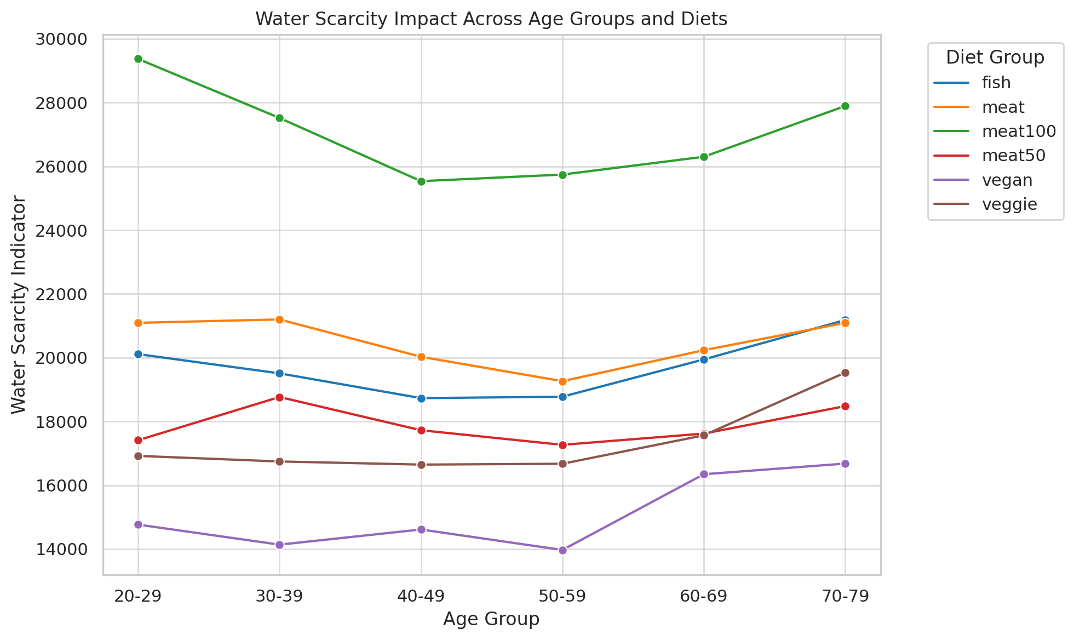
Part.
Eliminated visualization solutions
01

Slide 4
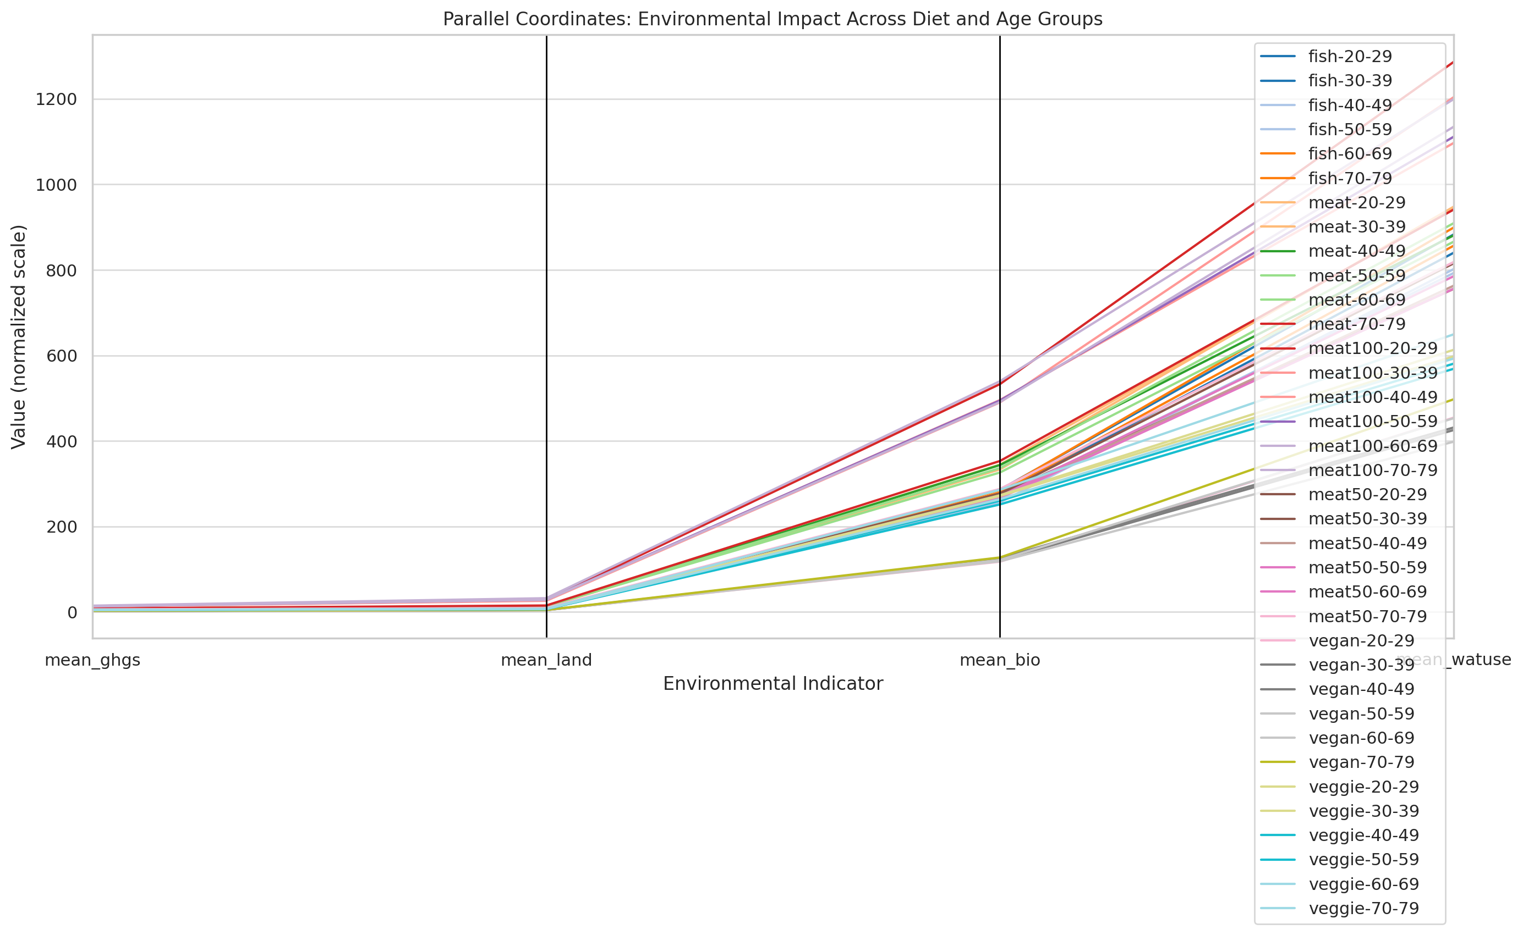
Part.
Eliminated visualization solutions
01

Slide 5
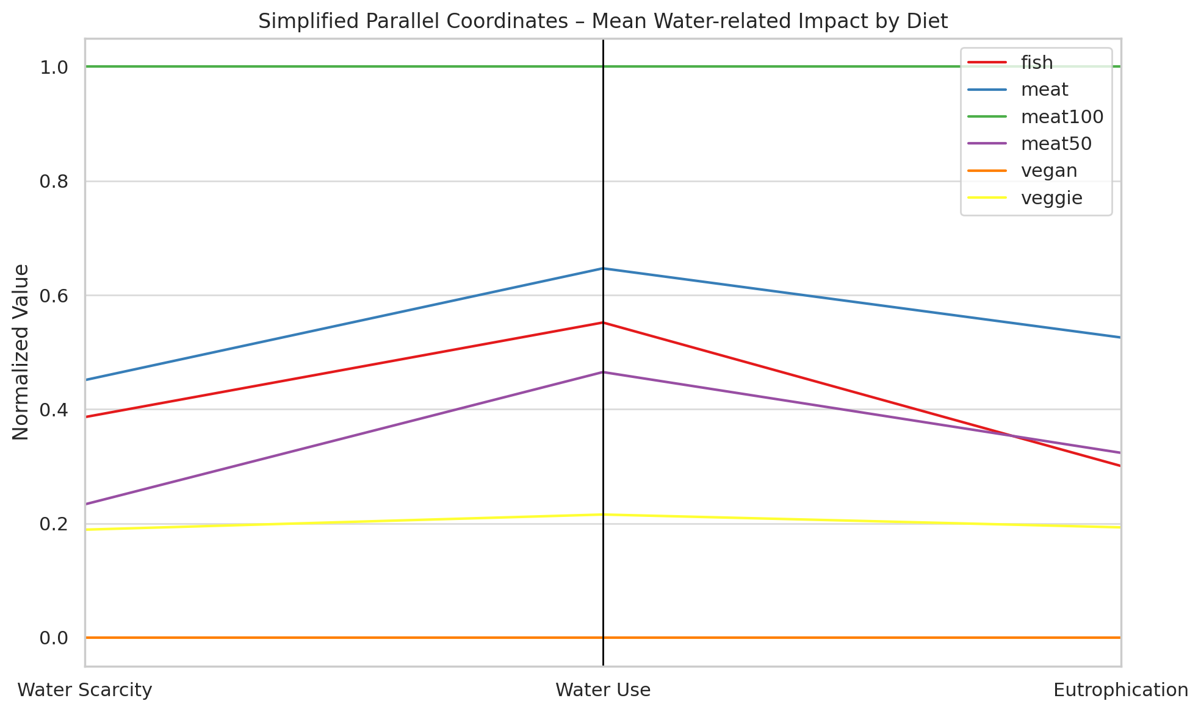
Part.
Possible visualization methods
02

Slide 6
Part.
Conclusion
03
A vegan diet isn’t just better for the climate—it also puts far less pressure on our water systems.

